Slide 1
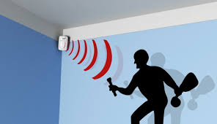
Smart City Monitor: Motion Detection
Metin Senturk
Pooja Umathe
Janam Dalal

Slide 2
Index
Tools and Technologies covered
Introduction
Algorithms to detect motion
Body (Background Subtraction)
Image clarification/definition in open CV platform
Removing the RGB from images converting to grey scale
Implementing Blur methodology to images
Locating differences in two frames
Identifying shape of objects in the frame
Displaying video results
Challenges
Conclusion

Slide 3
Tools and Technologies covered:
Python
Pandas
Numpy
Open CV

Slide 4
Introduction
The purpose of this project is to detect motion and describe the behavior of the motion through computation processing.
The focus is on studying objects in motion over when they are in a stationary phase.

Slide 5
Algorithms:
The methods used for the project are the following:
Mean Shift
Background Subtraction
Optical Flow

Slide 6
Background Subtraction
Image clarification/definition in open CV platform

Slide 7
Background Subtraction contd.
Important to note, before background subtraction is performed we must prepare the frame according to the steps below.
Resizing the frame image
Removing the RGB from frame and converting to grey scale- Since color does not apply for motion detection, the conversion of color to grey scale is performed.
Implementing Blur methodology to frame- Serves to remove high frequency noise in images.

Slide 8
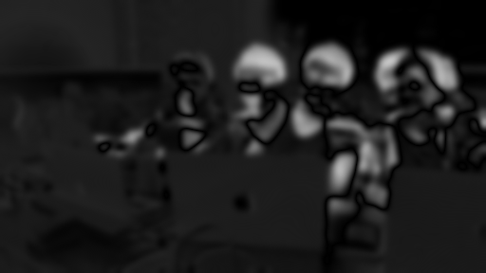
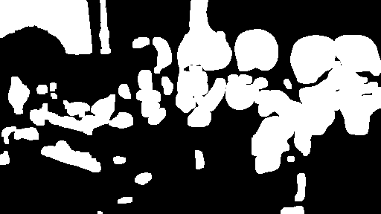
Background Subtraction contd.
Locating differences within two frames.
The first frame captured is assumed to be the background of the environment (T0), and following with the future frames their will be a comparison against T0 frame in order to recognize and differentiate object presence/motion.
Also, the step mentioned above can be further advanced by the means of comparing the current frame (T(N)) and then following by measuring the results against (T(N-1))
Once difference is identified between the number of frames, a threshold frame will be created.

Slide 9
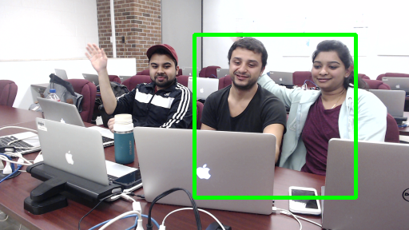

Background Subtraction contd.
Identifying shape of objects in the frame
The moving objects in the frame is recognized and highlighted with a rectangle.
Displaying video results
Thus results will be created allowing for user to investigate scenario.

Slide 10
Challenges
Camera object detection is not as efficient as expected.
If the camera is hampered it will lead to false signal of object detection.

Slide 11
Conclusion
Motion detection in the “Smart City” study will allow numerous implementations.
For instance, face detection in environment, hand gesture movements, tensor flow object detection, traffic patrol predictions, etc.

